Slide 1

Image Quilting for Texture Synthesis GROUP 24 Christof Leutenegger Lukas Nüesch Marco Heiniger Piero Neri

Slide 2
Quick recap: Base Implementation
Phase 1: Choose block
with best SSD overlap
3 cases for calculation of overlap in phase 1:
output image:
input image:
…
…
Phase 2: Perform optimal cut
on overlap region
output image:
Case 1:
Case 2:
Case 3:
Error: SSD
Error: SSD
Error: SSD + SSD - SSD

Slide 3
Optimization 1: Simple optimization
Case 3:
Removed unnecessary function calls (e.g., pow() )
The green square is computed only once
Iterate once over the error matrix for each block
Generated ILP when calculating SSD for an overlap
Before:
After:
pixel_t s1_data = s1.data[i * s1.jumpsize + j];
pixel_t s2_data = s2.data[i * s2.jumpsize + j];
int diff = s1_data - s2_data;
error += diff * diff;
diff11 = in[(i + k) * inj + (j + m) * 3 + 0] - out[(row_out + k) * outj + (col_out + m) * 3 + 0]; diff12 = in[(i + k) * inj + (j + m) * 3 + 1] - out[(row_out + k) * outj + (col_out + m) * 3 + 1]; diff13 = in[(i + k) * inj + (j + m) * 3 + 2] - out[(row_out + k) * outj + (col_out + m) * 3 + 2]; error1 = error1 + diff11 * diff11 + diff12 * diff12 + diff13 * diff13;

Slide 4
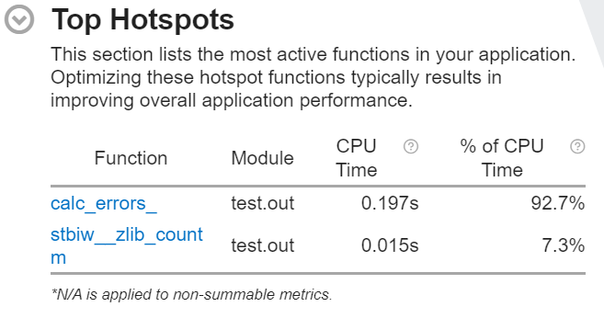

Optimization 1: VTune Profiler
Most of the time spent inside calc_errors
Let’s try to reduce instructions (next slide)

Slide 5

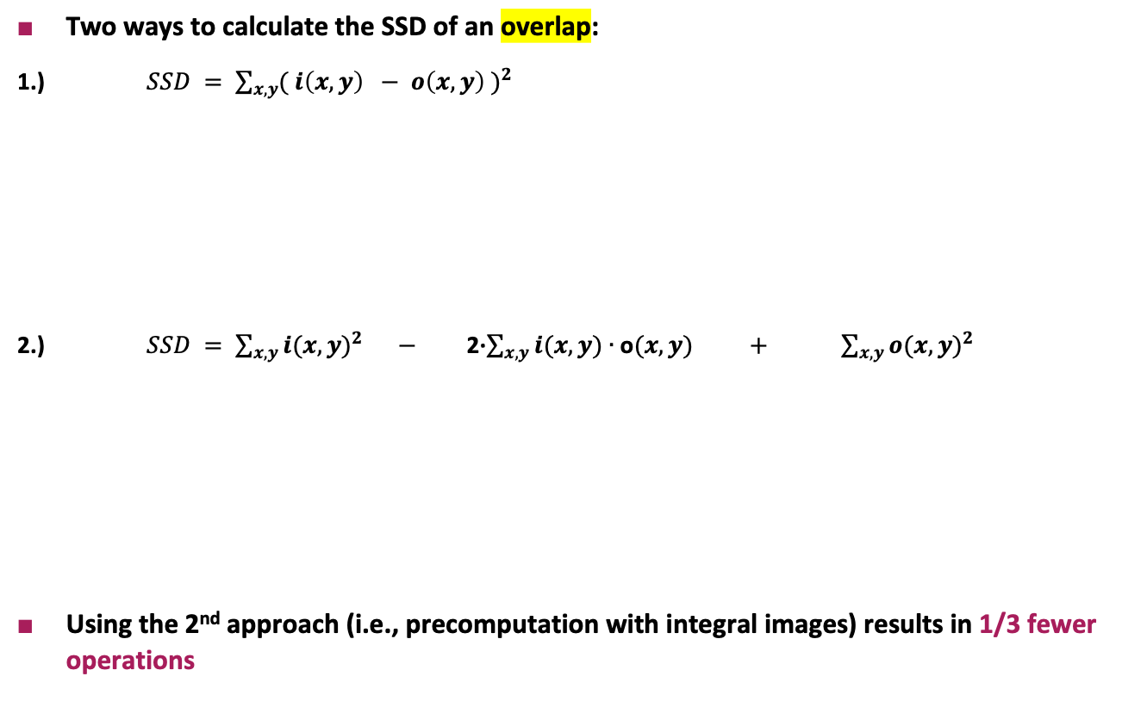
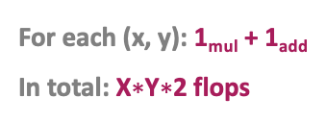
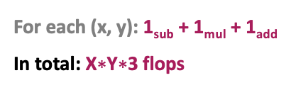
Optimization 2: Integral Images 1/2
output image:
X values
Two ways to calculate the SSD of an overlap:
1.) $SSD = \sum_{x,y}{{( i\left(x,y\right) − o\left(x,y\right) )}^{2}}$
2.) $SSD = \sum_{x,y}{{i(x,y)}^{2}}$ $−$ 2∙$\sum_{x,y}{i(x,y)∙\text{o}(x,y)}$ $+$ $\sum_{x,y}{{o(x,y)}^{2}}$
Using the 2nd approach (i.e., precomputation with integral images) results in 1/3 fewer operations
Y values
For each (x, y): 1_{sub} + 1_{mul} + 1_{add}
In total: X$∗$Y$∗$3 flops
Integral: 4_{adds}
For each (x, y): 1_{mul} + 1_{add}
In total: X$∗$Y$∗$2 flops
negligible, as this integral is
calculated once for all overlaps
in the input image
In total: ≈ X$∗$Y$∗$2 flops

Slide 6
Optimization 2: Integral Images 2/2
SSD calculation with integral images can only be used if region of output image can still be found in the input image
We distinguish between 4 cases:
Integral SSD
Normal SSD
Case 1:
Case 2:
Case 3:
Case 4:

Slide 7
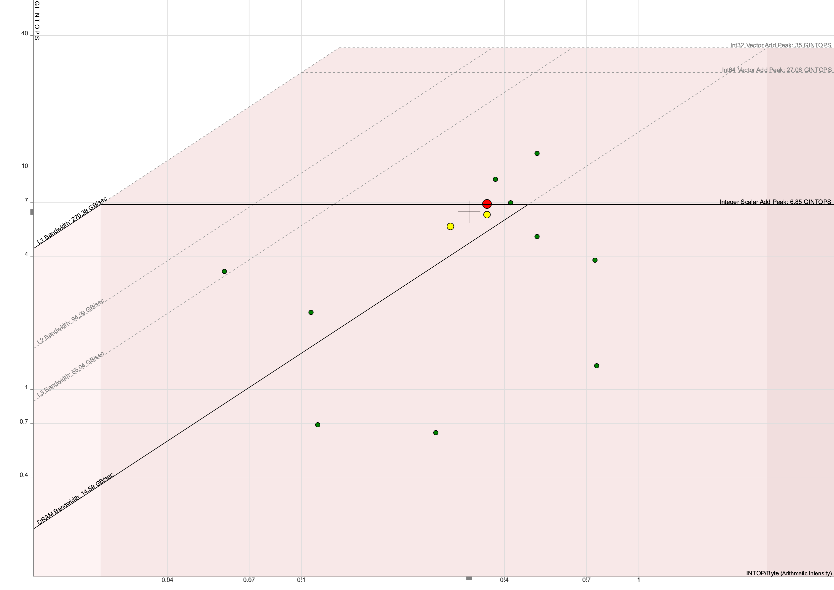
Optimization 2: Roofline plot
Compute bound → It’s time to vectorize!

Slide 8
Optimization 3: Vectorization
errors matrix
input image
output image:
…
8 entries
8 overlaps
1 overlap

Slide 9
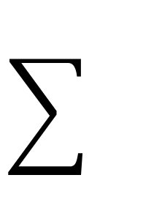
Optimization 3: Vectorization
errors matrix
input image
output image:
…
8 entries
8 overlaps
1 overlap
Vector with
16 uint16_t

Slide 10
Optimization 3: Vectorization
errors matrix
input image
output image:
…
8 entries
8 overlaps
1 overlap
Vector with
16 uint16_t

Slide 11
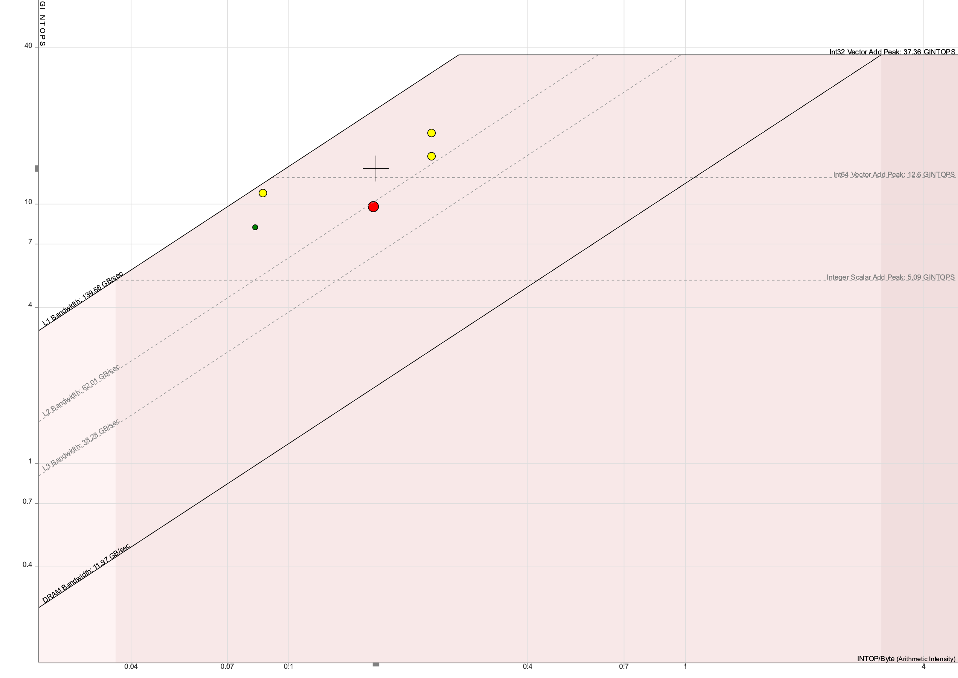
Optimization 3: Roofline plot
Proportions are right, but intops might be wrong. Memory bound now

Slide 12
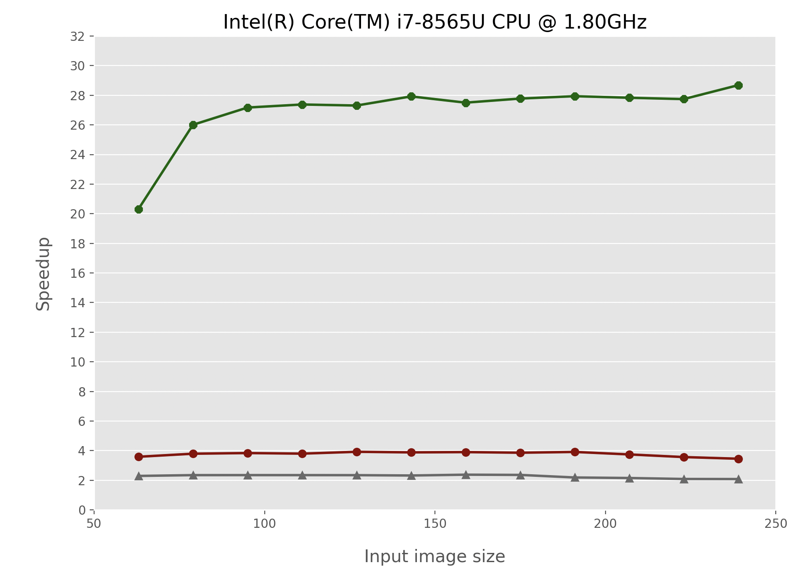
Experimental results on speedup 1/3
Optimization 3
Optimization 2
Optimization 1

Slide 13
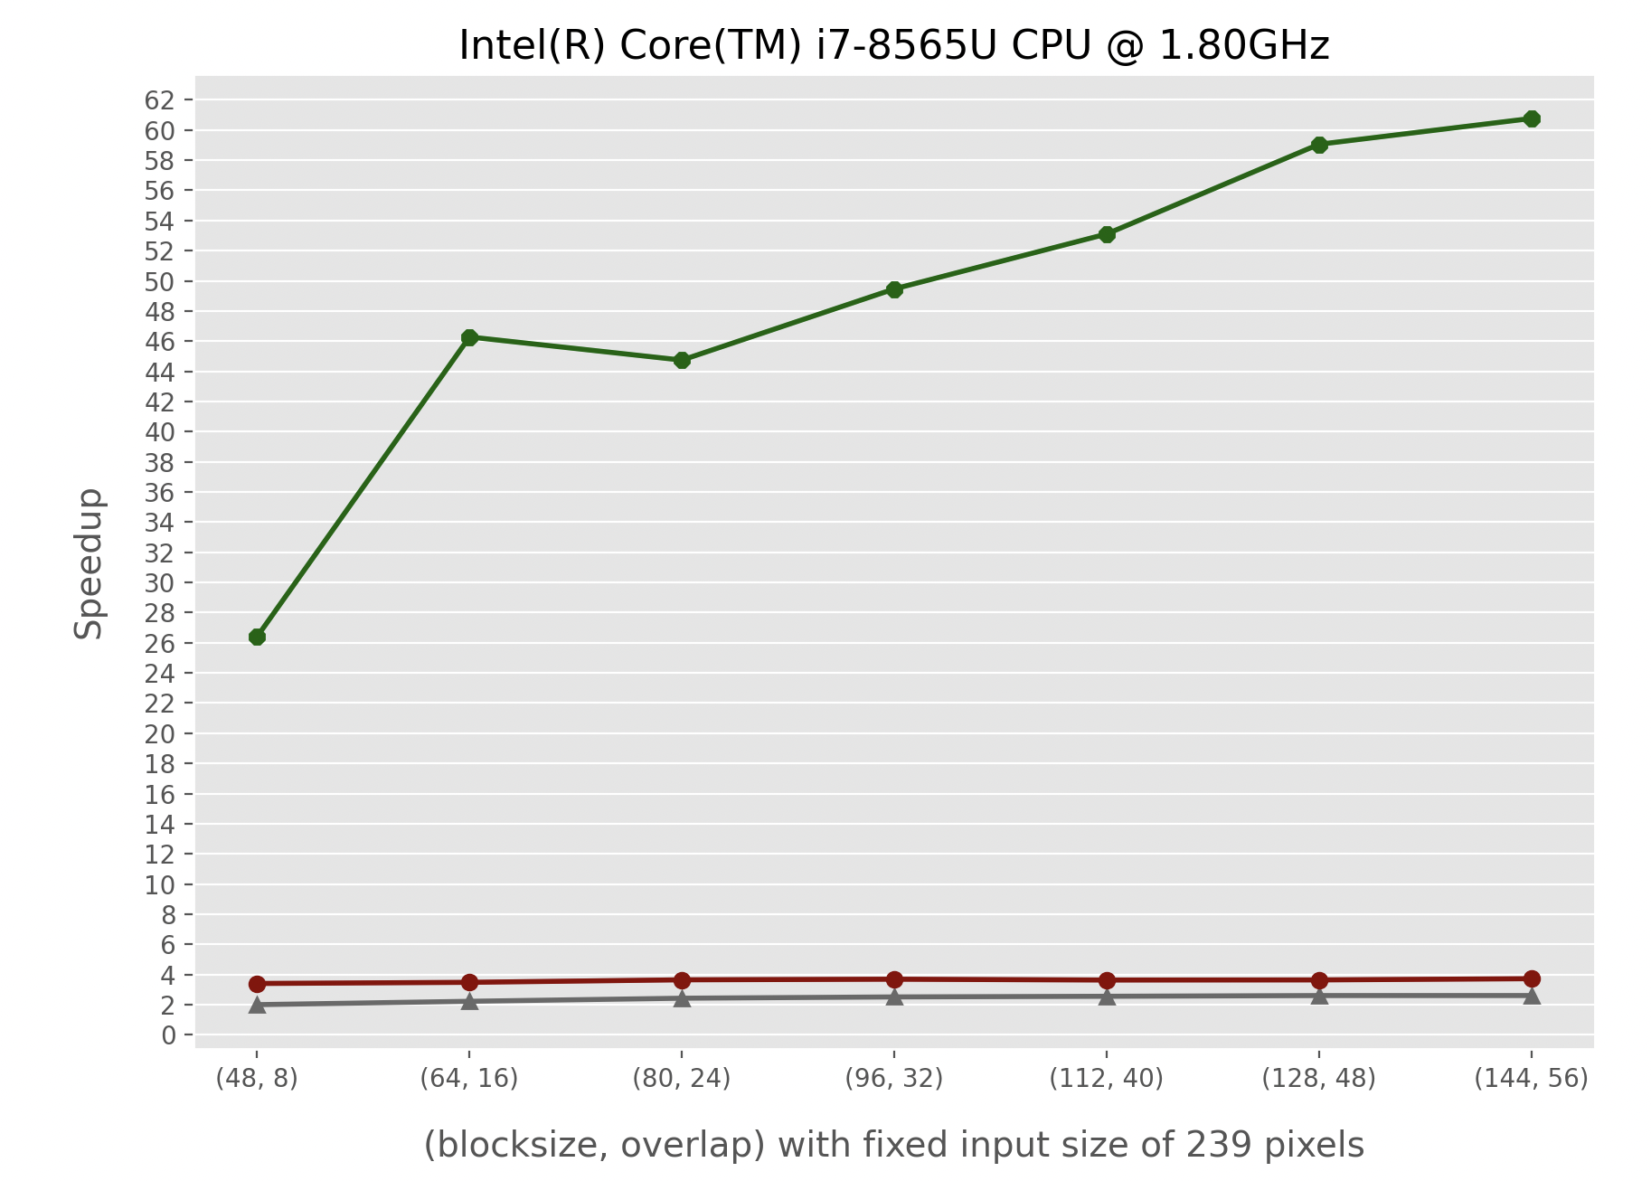
Experimental results on speedup 2/3
Optimization 3
Optimization 2
Optimization 1

Slide 14
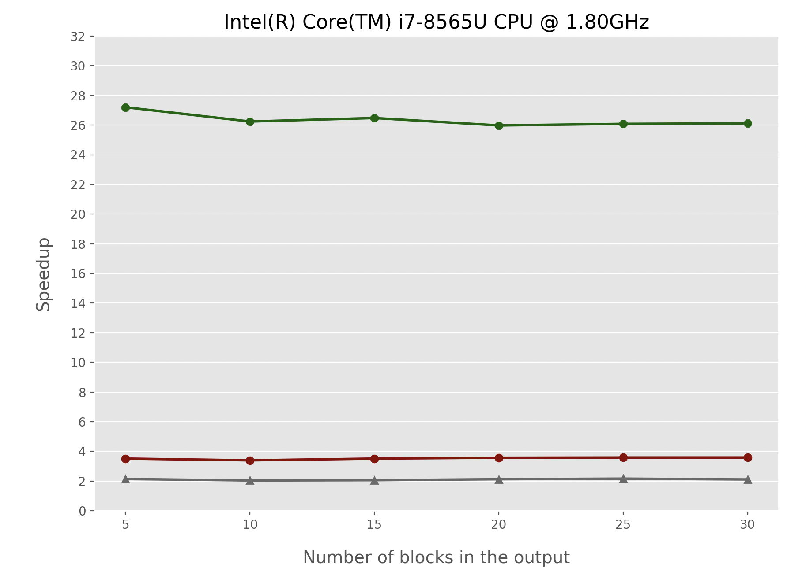
Experimental results on speedup 3/3
Optimization 3
Optimization 2
Optimization 1

Slide 15
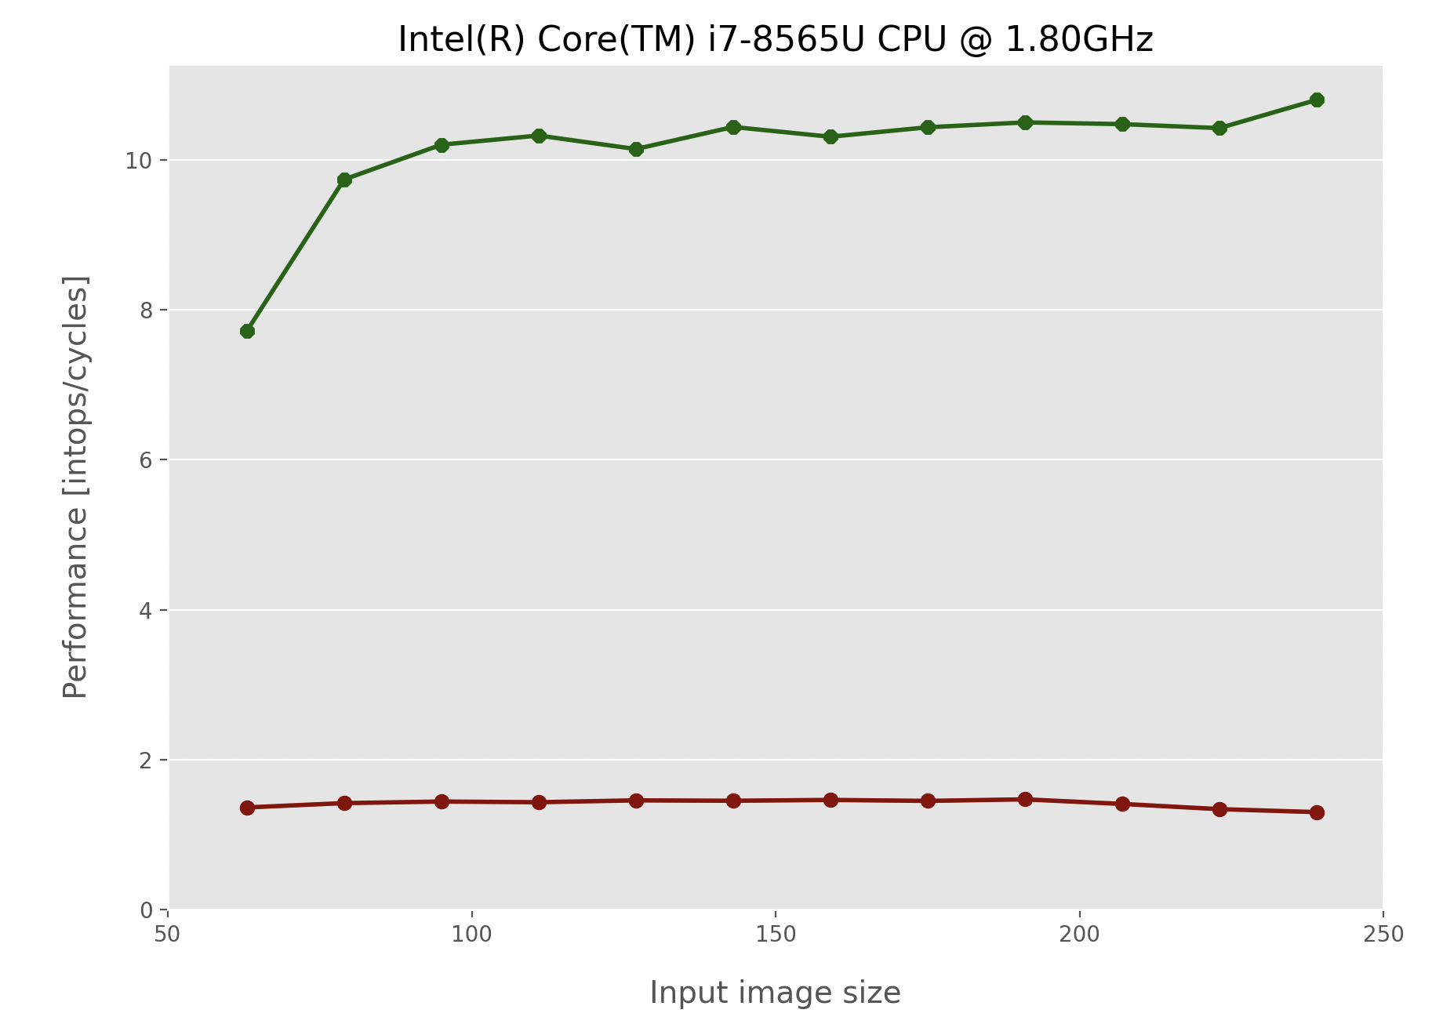
Experimental results on performance 1/3
Optimization 3
Optimization 2

Slide 16
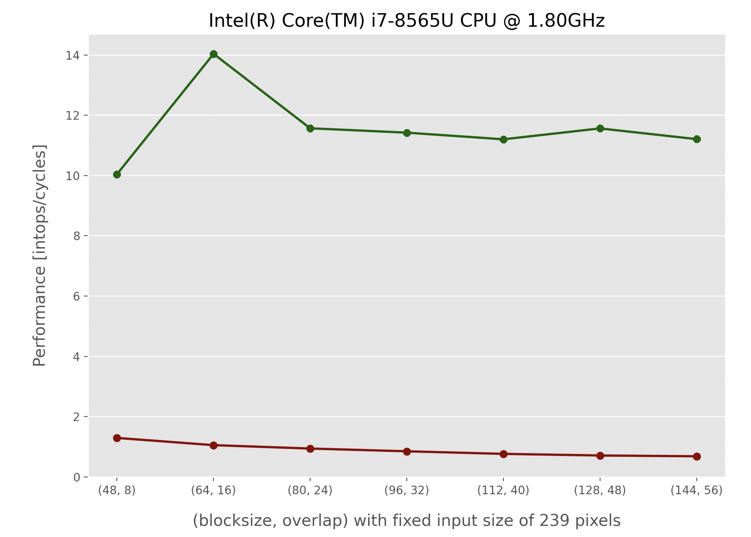
Experimental results on performance 2/3
Optimization 3
Optimization 2

Slide 17
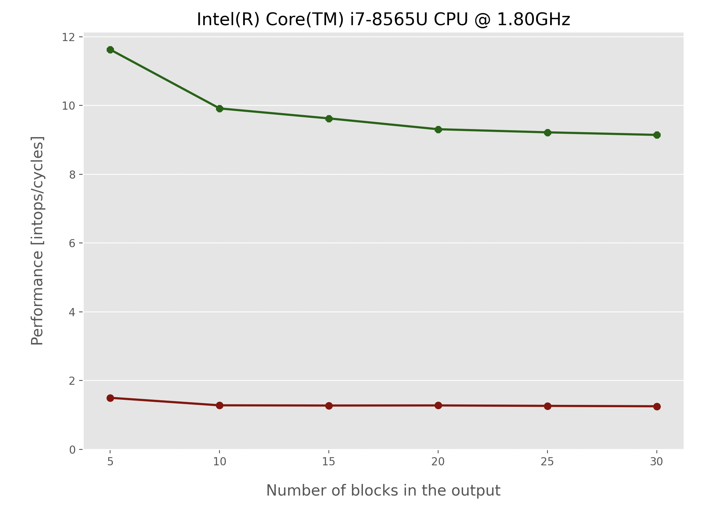
Experimental results on performance 3/3
Optimization 3
Optimization 2

Slide 18
The presentation ends here Backup slides…

Slide 19
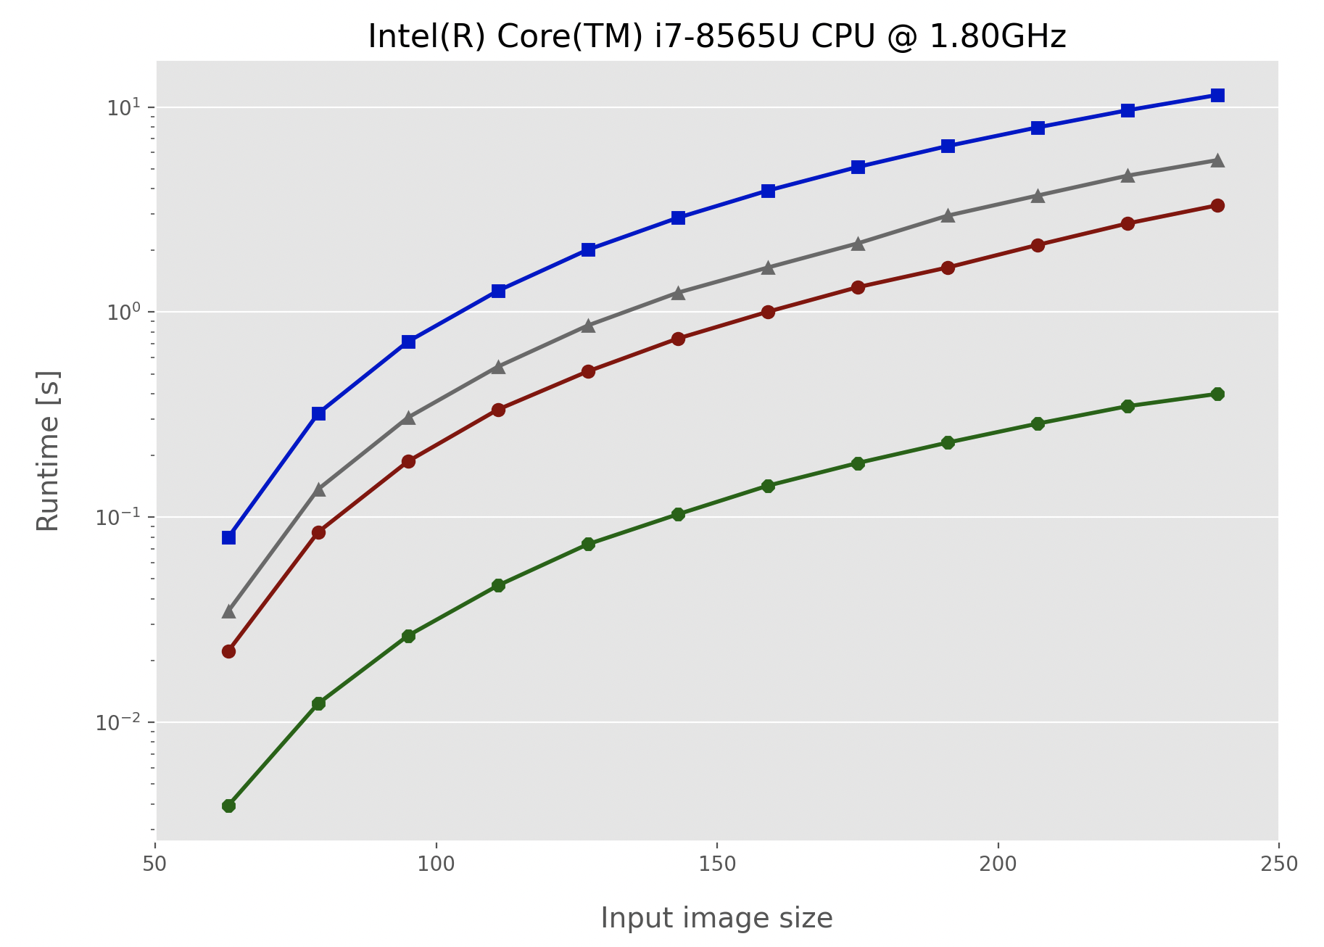
Experimental results on runtime 1/3
Base Implementation
Optimization 1
Optimization 2
Optimization 3

Slide 20
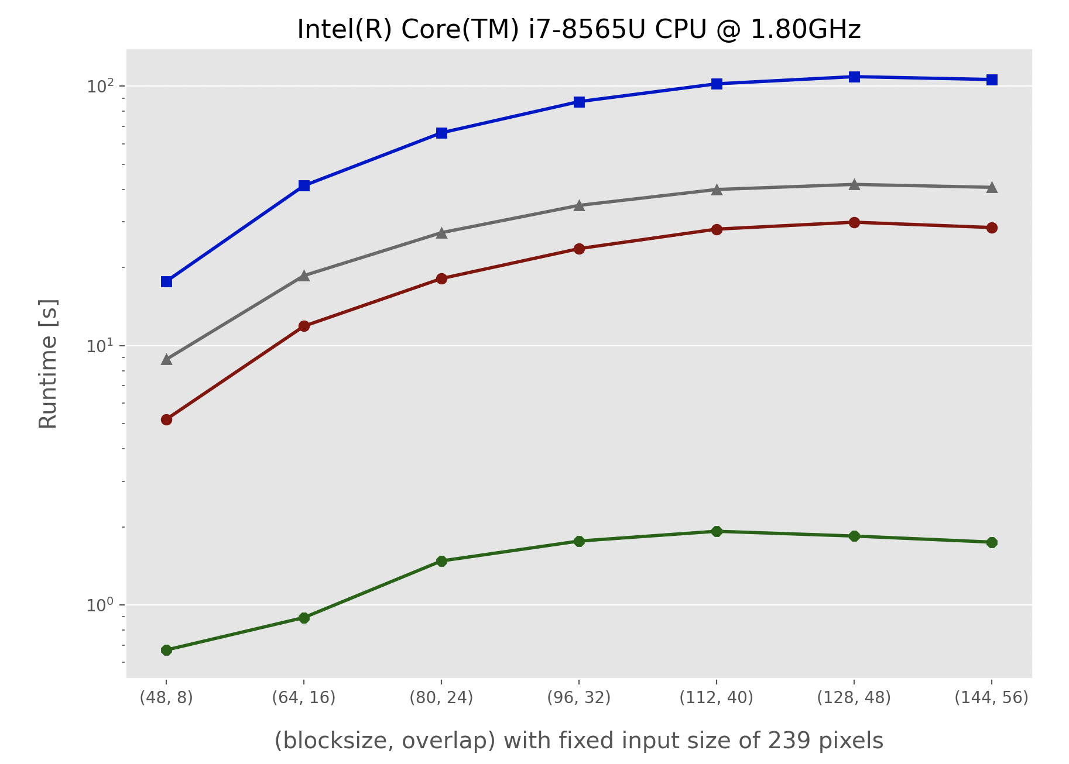
Experimental results on runtime 2/3
Base Implementation
Optimization 1
Optimization 2
Optimization 3

Slide 21
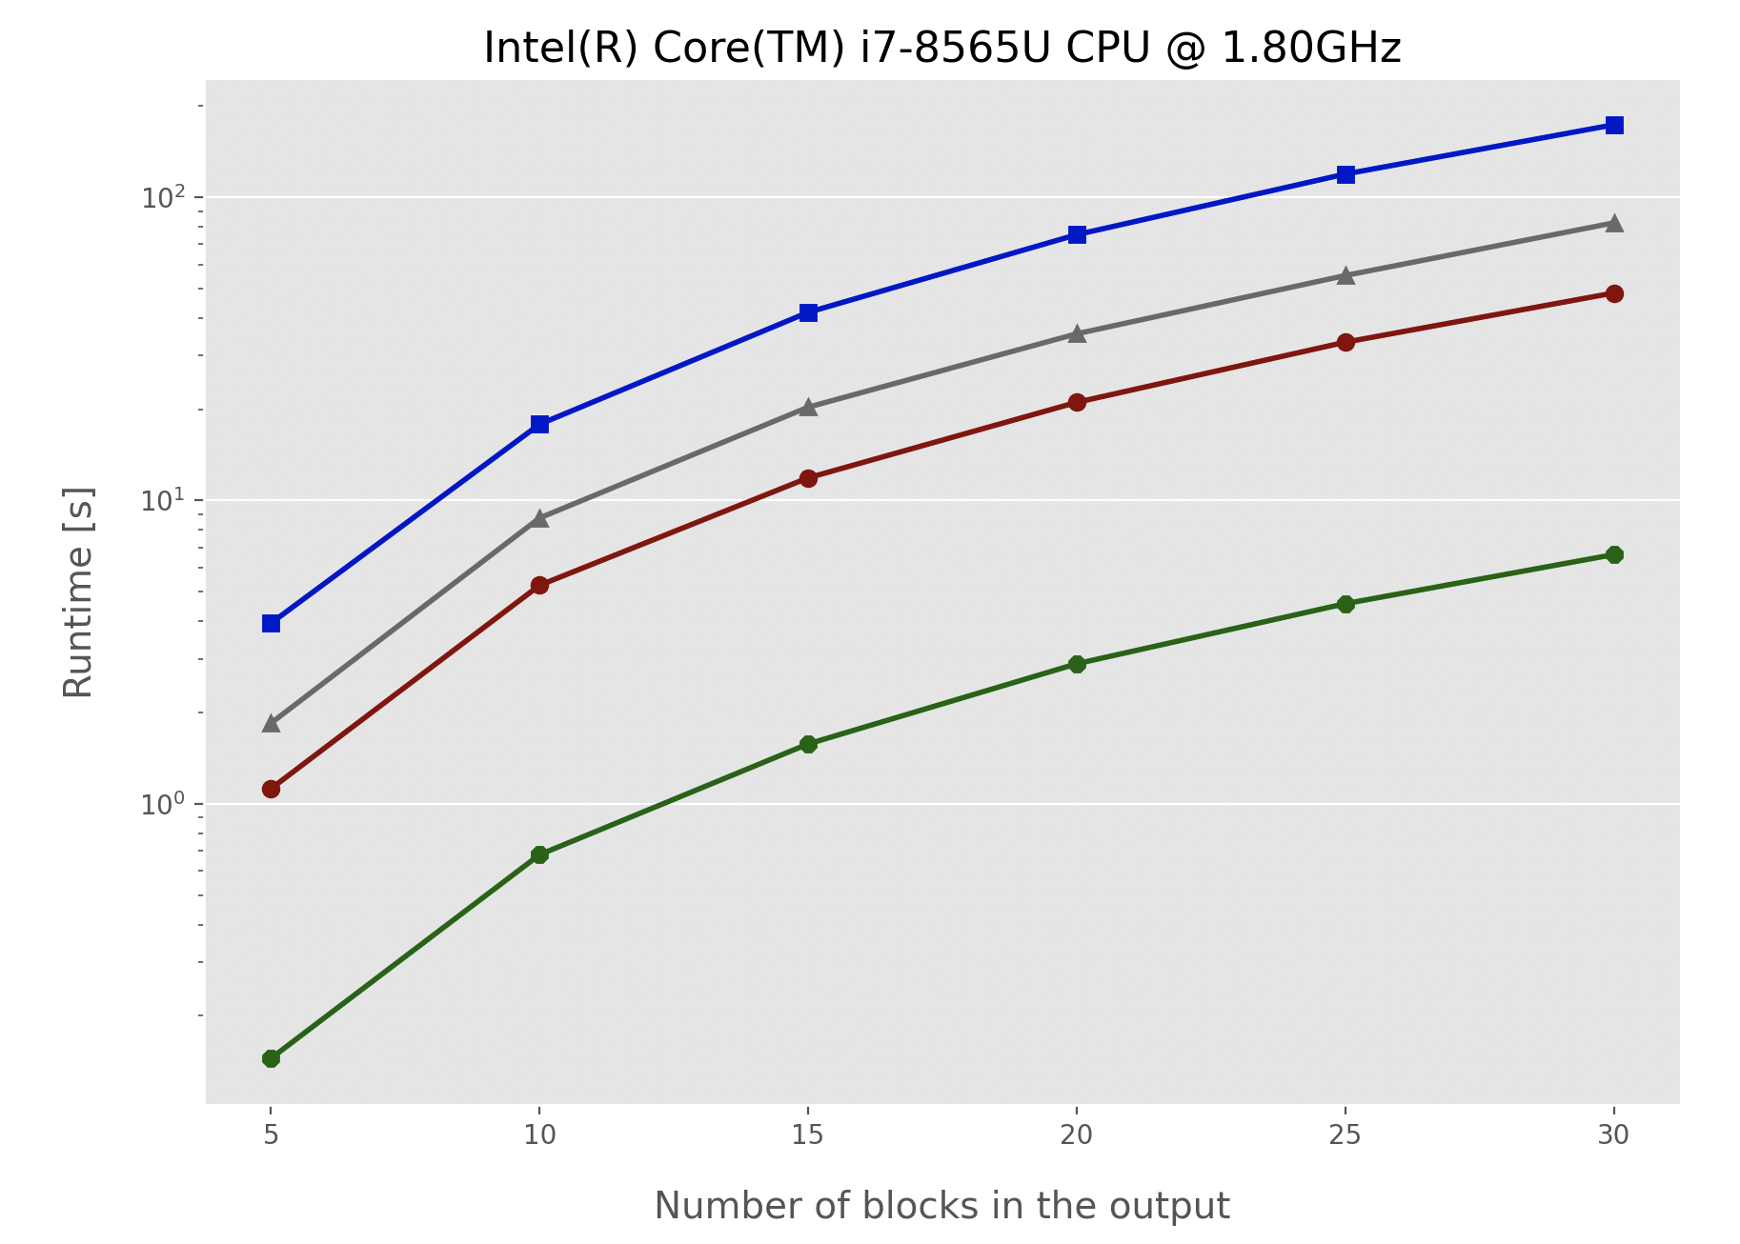
Experimental results on runtime 3/3
Base Implementation
Optimization 1
Optimization 2
Optimization 3

